Slide 1
Interim Analysis of a Prospective Multicenter Study Assessing Radiographic and Patient Outcomes Following a Mini-Open Triplanar Tarsometatarsal Arthrodesis with Early Weightbearing
Interim Analysis of a Prospective Multicenter Study (Mini3D™)
Justin Daigre, MD
DOC Orthopaedics and Sports Medicine

Slide 2
Disclosures
Authors
J Daigre, MD¹; R Santrock, MD²; A Chhabra, MD³; JE McAlister, DPM⁴; R Taylor, DPM⁵; D Farber, MD⁶;
A Raissi, MD⁷; P Steinke, DPM⁸; M Allen, DPM⁹; A Shane, DPM¹⁰; D Kile, MS¹¹; JP McAleer, DPM¹²
¹ DOC Orthopaedics and Sports Medicine, Decatur, AL
² Duke University, Durham NC
³ University of Texas Southwestern Medical Center, Dallas, TX
⁴ Phoenix Foot and Ankle Institute, Phoenix, AZ
⁵ Stonebriar Foot and Ankle, Frisco, TX
⁶ University of Pennsylvania, Philadelphia, PA
⁷ Desert Orthopaedic Center, Las Vegas, NV
⁸ Foot and Ankle Associates of North Texas, Keller, TX
⁹ Sports Medicine Associates of San Antonio, San Antonio, TX
¹⁰ AdventHealth/Upperline Health, Orlando, FL
¹¹ Actalent Services, Inc.
¹² Jefferson City Medical Group, Jefferson City, MO
Disclosures
Study was funded by Treace Medical Concepts, Inc.
All authors are considered consultants and/or receive royalties and/or research funding from Treace Medical Concepts, Inc.

Slide 3
Introduction
Interim results from a 2-year prospective multicenter study to evaluate the use of an instrumented system for triplanar 1st TMT correction of HV deformities through a mini-open incision:
Reproducibility of correction
Outcomes of early weightbearing
Maintenance of correction
Patient-reported outcomes

Slide 4
Study Methods
Mini3D™ prospective multicenter study
(9 sites and 9 surgeons): 2-year follow-up
Inclusion criteria:
14-58 years of age
Symptomatic HV (IMA between 10.0 - 22.0°; HVA between 16.0 - 40.0°)
Exclusion criteria:
Prior HV surgery
BMI > 40 kg/m2
HbA1c ≥ 7
Evidence of peripheral neuropathy
Radiographic reader: One independent fellowship trained musculoskeletal radiologist
Outcomes evaluated (12 mo follow-up):
Radiographic recurrence
Return to weightbearing and activities
Pain measured by visual analog scale (VAS)
Manchester-Oxford Foot Questionnaire (MOxFQ)
Metatarsus adductus ≥ 23°
Moderate to severe osteoarthritis of the first metatarsophalangeal (MTP) joint complex
Current use of nicotine
Circumferential measurements
Scar analysis
Complications

Slide 5
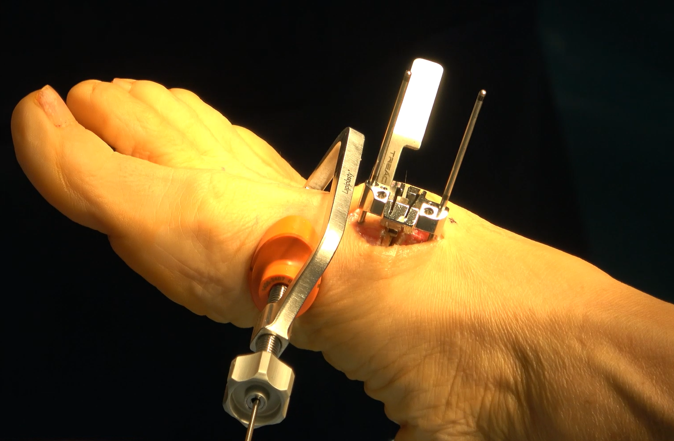
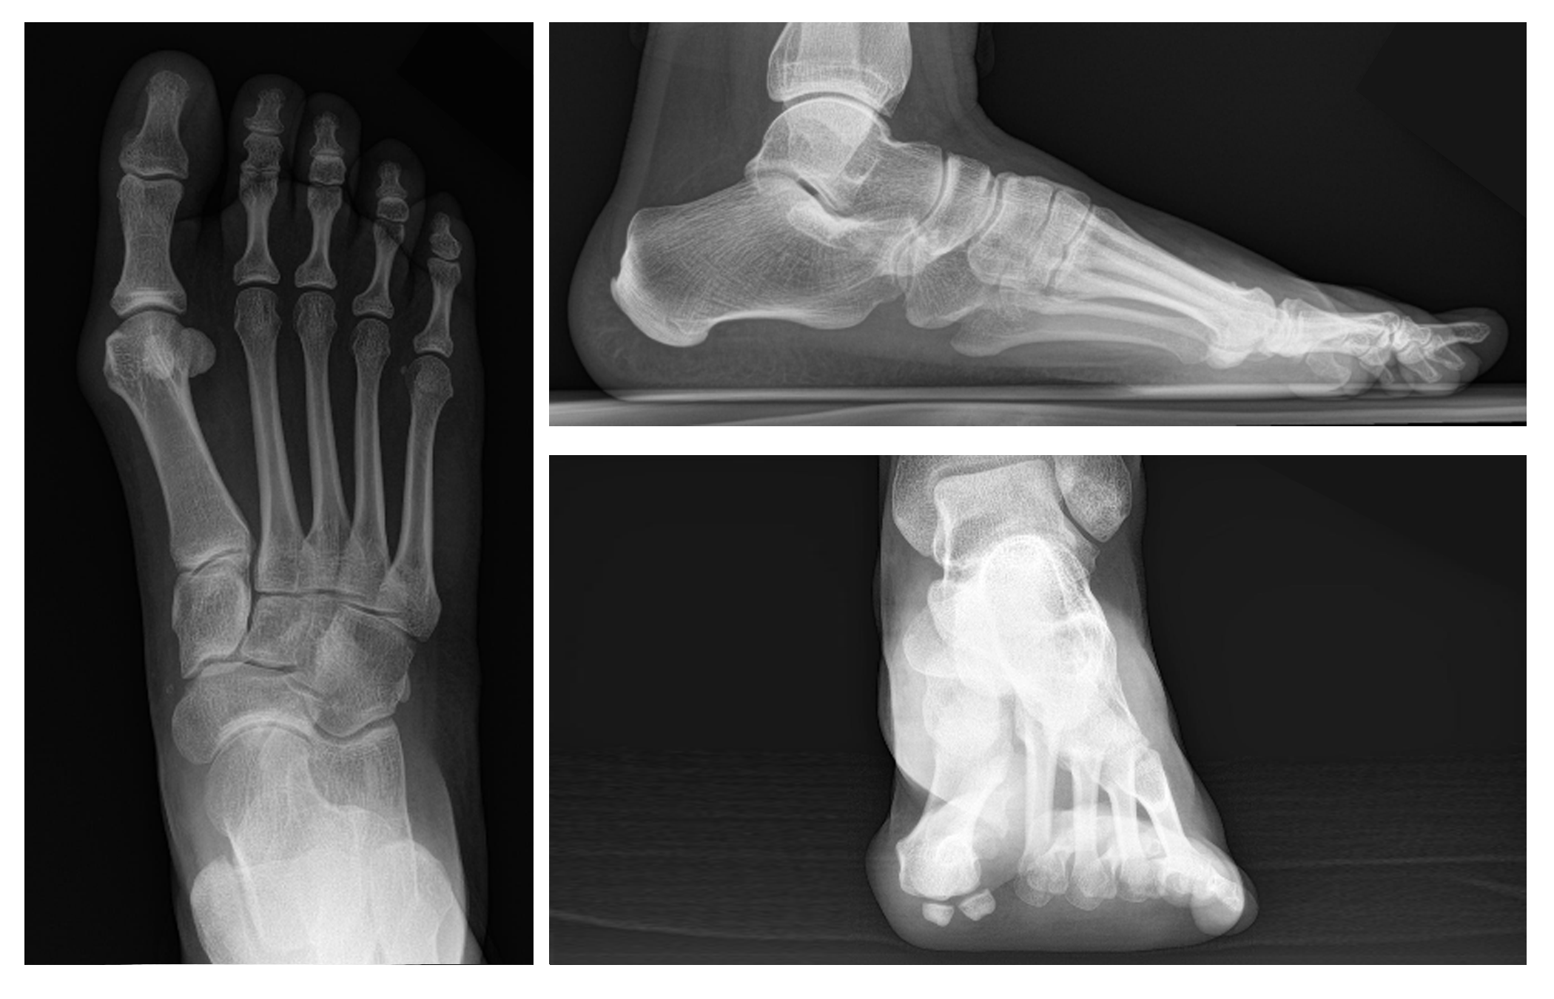
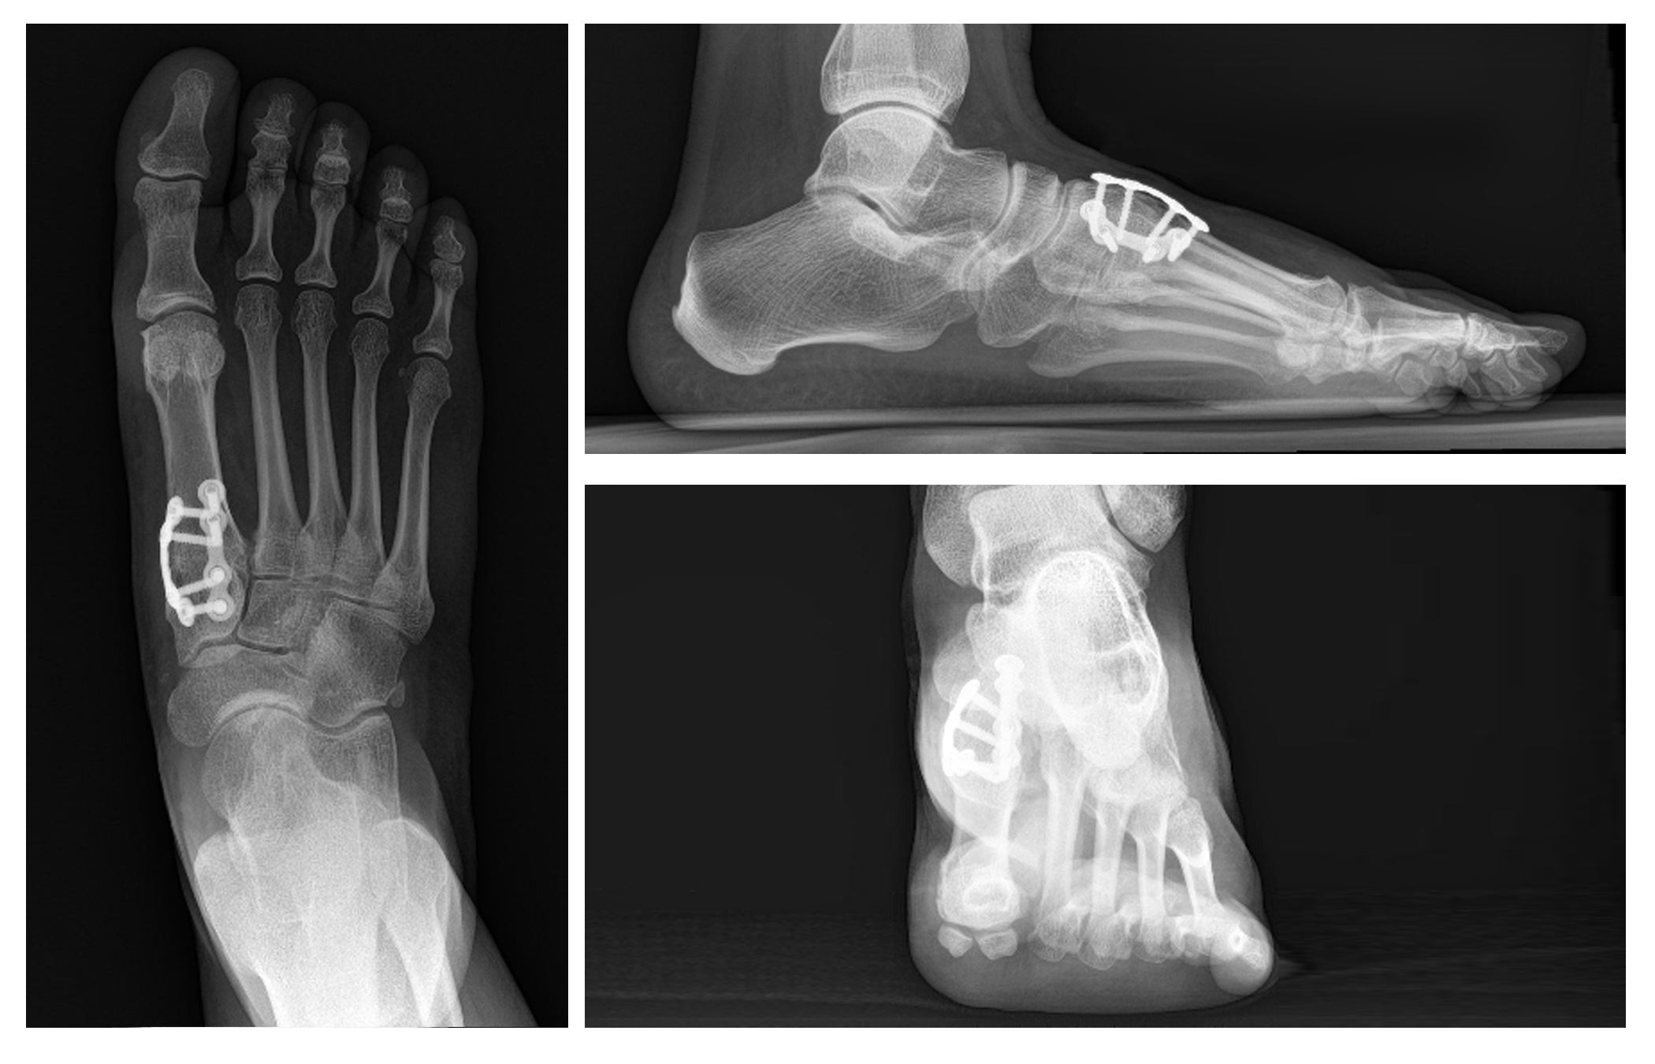
Surgical Methods
Mini-Open 1st TMT Arthrodesis:
Patients treated with an instrumented 1st TMT procedure through a mini-open (<4cm) dorsal incision
Instrument-assisted triplanar deformity correction with a cut guide for TMT joint cuts
Biplanar locking construct with protected early weightbearing
Baseline
24 Month

Slide 6
Results: Demographics and Baseline Characteristics
82/105 patients have completed their 12-month follow up visit and 11 patients completed their 24-month follow up.
Early protected weightbearing in an average of 7.9 days (SD=6.0).
Baseline Characteristics | Category | Patient Population
Age (years), mean (SD) |  | 41.0 (12.4)
Sex, n (%) | Male | 7 (6.7%)
 | Female | 98 (93.3%)
BMI category | Underweight | 3 (2.9%)
 | Normal Weight | 53 (50.5%)
 | Overweight | 31 (29.5%)
 | Obese | 18 (17.1%)

Slide 7
Results: Radiographic Measures
Significant (p<0.05) improvements over baseline in radiographic measures (HVA, IMA, TSP, osseous foot width) at all post-op time points through 12 months
94.2% (98/104) of patients achieved 6-week correction*.
Average metatarsal shortening of 2.4mm at 12 months.
Radiographic Measures, Mean (95% Confidence Interval)
Radiographic measure | Baseline (N=105) | 6 Week (N=104) | 6 Month (N=98) | 12 Month (N=75) | 24 Month (N=11)
Hallux Valgus Angle (HVA) | 26.6° (25.3, 27.8) | 6.4° (5.2, 7.6) | 6.5° (5.1, 7.8) | 7.1° (5.6, 8.6) | 5.6° (3.3, 7.8)
Intermetatarsal Angle (IMA) | 14.1° (13.5, 14.6) | 3.7° (3.2, 4.3) | 4.7° (4.0, 5.3) | 4.8° (4.1, 5.6) | 3.0° (1.6, 4.3)
Tibial Sesamoid Position (TSP) | 5.0 (4.8, 5.3) | 1.7 (1.5, 1.9) | 2.3 (2.1, 2.6) | 2.7 (2.4, 3.0) | 1.9 (1.4, 2.5)
Sagittal-Plane Intermetatarsal Angle | 0.3° (-0.1, 0.8) | 1.8° (1.2, 2.3) | 1.3° (0.8, 1.9) | 1.4° (0.8, 2.0) | 1.1° (-1.3, 3.5)
Osseous Foot Width (mm) | 91.0 (89.1, 93.0) | __ __ | 83.7 (81.7, 85.6) | 83.3 (81.1, 85.5) | 79.3 (75.6, 83.1)
*Correction is defined as any two of the following 3 criterion being met at 6 weeks post-procedure: IMA <9.0°, HVA <15.0°, and TSP <=3.

Slide 8
Results: Radiographic Recurrence
Recurrence was assessed using two thresholds from literature: HVA >15° or HVA >20°.
None of the patients had recurrence using post-op HVA of >20° at 12 or 24 months.
Visit | Recurrence Definition Rate (95% CI of the proportion)
 | HVA >15° | HVA >20°
12 Month | 5.5% (4/73) (1.51, 13.44) | 0.0% (0/73)
24 Month | 0.0% (0/11) | 0.0% (0/11)

Slide 9
Results: Circumferential Measurements
Circumferential Measurements in cm, Mean (95% Confidence Interval)
Swelling Measures | Baseline (n=105*) | 6 Week (n=104) | 6 Month (n=98) | 12 Month (n=75)
Forefoot Circumference | 20.7 (20.1, 21.3) | 20.8 (20.2, 21.5) | 20.2 (19.5, 20.8) | 19.8 (19.1, 20.5)
Midfoot Circumference | 20.2 (19.6, 20.8) | 20.9 (20.3, 21.5) | 20.5 (19.9, 21.1) | 20.2 (19.6, 20.9)
Calf Circumference | 33.4 (32.5, 34.3) | 31.5 (30.6, 32.3) | 32.4 (31.5, 33.3) | 32.9 (32.0, 33.8)
*One subject was missing measurements for Forefoot and Midfoot
Notes:
Main takeaway here – swelling was not significant

Slide 10
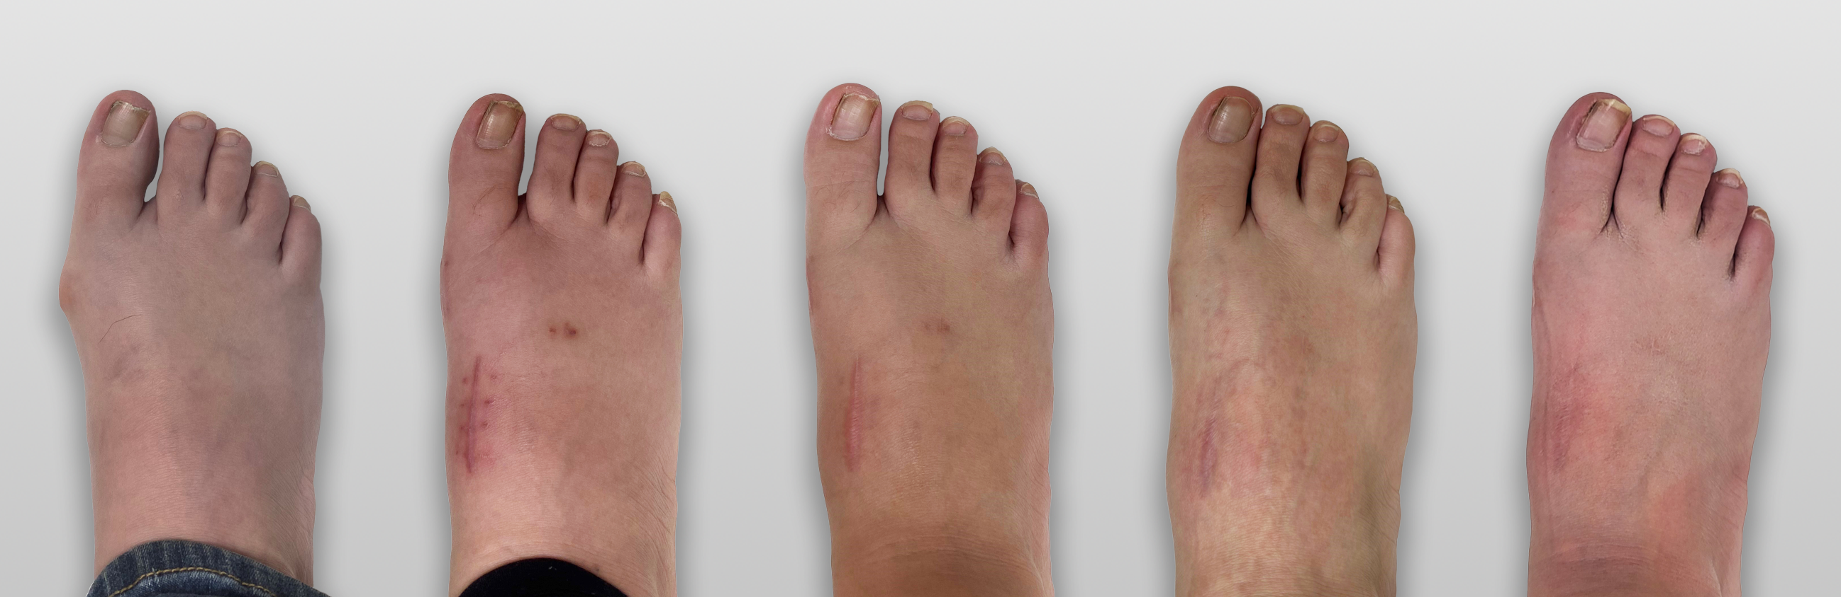
Results: Scar Analysis
Representative preoperative (left) and 24month postoperative (right) incision/scar assessments
Baseline 6 Week 6 Month 12 Month 24 Month
Notes:
This is subject 101-011 (McAleer)

Slide 11
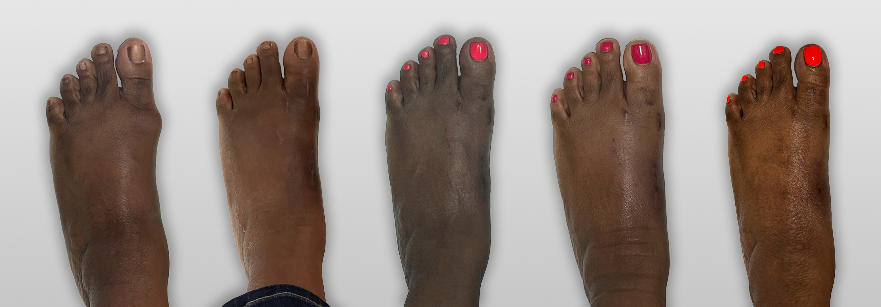
Results: Scar Analysis
Representative preoperative (left) and 12month postoperative (right) incision/scar assessments
Baseline 6 Week 4 Month 6 Month 12 Month
Notes:
This is subject 105-006 (Shane)

Slide 12
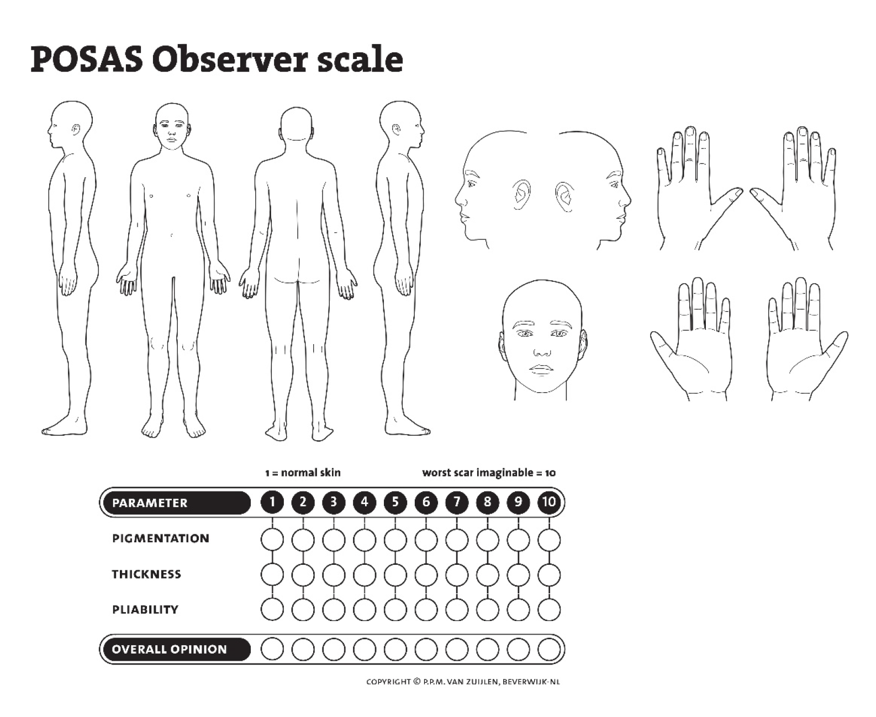
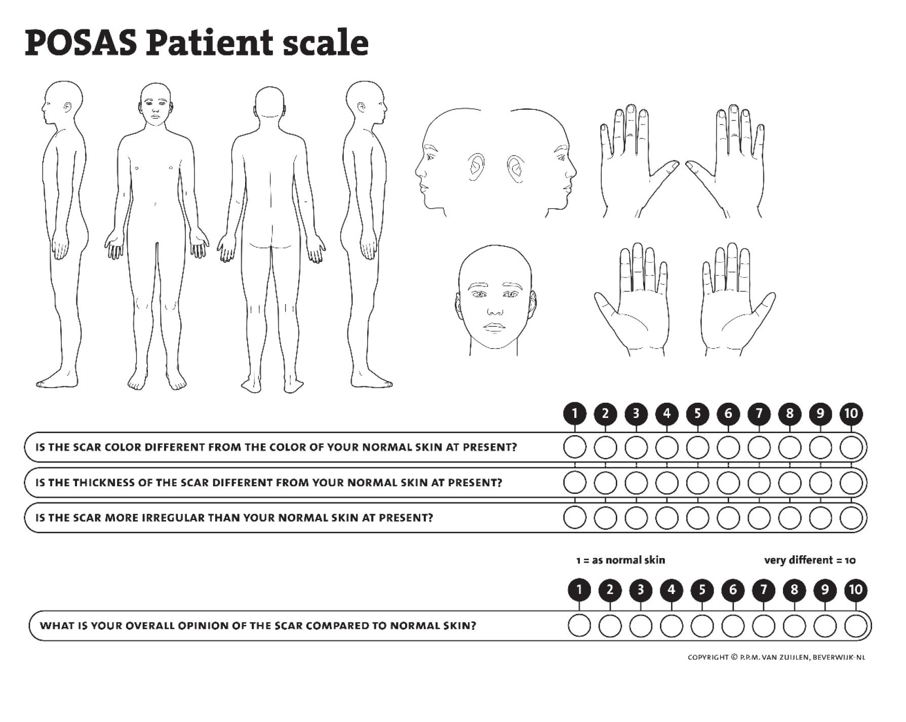
POSAS: Patient and Observer Assessment Scale
Survey question examples
POSAS is part of the Dutch Burns Foundation copyright © p.p.m. van zuijlen, beverwijk-nl
Zeestraat 29 | 1941 AJ Beverwijk | The Netherlands
For more information or for a free license, e-mail: info@posas.nl

Slide 13
Results: Incision Length and Scar Analysis
Clinically meaningful cosmetic appearance of the scar was observed over time.
Incision Length (cm)
Median (Min, Max) | 3.5 (3.0, 4.0)
POSAS* (Mean 95% Confidence Interval)
 | 4 Month (n=98) | 6 Month (n=98) | 12 Month (n=75) | 24 Month (n=11)
Observer | 14.6 (13.4, 15.9) | 12.1 (11.2, 13.1) | 10.8 (9.8, 11.8) | 7.5 (6.2, 8.7)
Patient | 22.7 (20.4, 24.9) | 18.2 (16.0, 20.4) | 13.4 (11.6, 15.2) | 8.8 (5.3, 12.4)
*POSAS (Patient and Observer Scar Assessment Scale) – Total POSAS score can range from 6 to 60 and is calculated by summing the 6 component scores. A lower score denotes similarity to normal skin.

Slide 14
Results: Patient Reported Outcomes
Significant improvement over baseline in VAS and MOxFQ through 12m post-op.
Continued improvement observed in the n=11 patients who have 24-month data.
VAS Mean (95% Confidence Interval)
Measure | Baseline (n=105) | 6 Week (n=104) | 6 Month (n=98) | 12 Month (n=74) | 24 Month (n=11)
VAS Pain Score | 3.5 (3.1, 3.9) | 1.6 (1.4, 1.9) | 1.2 (0.9, 1.5) | 0.9 (0.7, 1.2) | 1.0 (0.0, 2.0)
MOxFQ Mean (95% Confidence Interval)
Measure | Baseline (n=105) | 6 Month (n=98) | 12 Month (n=75) | 24 Month (n=11)
MOxFQ (Walk/Stand) | 41.2 (36.7, 45.8) | 17.6 (13.6, 21.7) | 8.8 (5.4, 12.1) | 7.8 (-1.6, 17.1)
MOxFQ (Pain) | 50.2 (46.6, 53.9) | 22.8 (19.0, 26.6) | 14.5 (10.9, 18.0) | 10.5 (-2.6, 23.5)
MOxFQ (Social Interaction) | 42.7 (38.7, 46.8) | 14.0 (10.4, 17.6) | 9.0 (5.9, 12.1) | 6.8 (-7.0, 20.7)
MOxFQ (Index Score) | 44.4 (40.8, 48.1) | 18.4 (14.7, 22.0) | 10.6 (7.6, 13.6) | 8.4 (-2.9, 19.6)

Slide 15
Results: Patient Reported Outcomes
Significant improvements were observed across all PROMIS domains at 6 and 12 months post-operatively.
Continued improvements were also observed in the N=10 24-month subjects.
Domain | Baseline (N=99) | 6 Month (N=92) | 12 Month (N=70) | 24 Month (N=10)
Ability to Participate in Social Roles/Activities | 54.1 (52.3, 56.0) | 59.3 (57.9, 60.7) | 61.5 (60.3, 62.7) | 61.5 (58.3, 64.7)
Anxiety | 48.3 (46.3, 50.2) | 44.2 (42.7, 45.8) | 43.7 (42.2, 45.1) | 44.3 (39.6, 48.9)
Depression | 44.9 (43.3, 46.4) | 43.3 (42.1, 44.5) | 43.8 (42.3, 45.3) | 42.9 (40.0, 45.8)
Fatigue | 45.8 (43.7, 47.8) | 41.9 (39.9, 43.8) | 41.2 (39.2, 43.2) | 38.9 (34.0, 43.7)
Pain Intensity | 3.9 (3.5, 4.3) | 1.3 (1.0, 1.7) | 0.9 (0.6, 1.2) | 1.1 (-0.4, 2.6)
Pain Interference | 54.1 (52.4, 55.8) | 45.6 (44.2, 47.0) | 43.6 (42.6, 44.7) | 44.6 (41.0, 48.2)
Physical Function | 45.9 (44.2, 47.5) | 52.9 (51.6, 54.3) | 55.0 (53.9, 56.0) | 55.4 (51.6, 59.1)
Sleep Disturbance | 49.1 (47.6, 50.6) | 44.9 (43.1, 46.8) | 44.3 (42.4, 46.2) | 44.4 (38.2, 50.6)

Slide 16
Results: Metatarsalgia
Significant resolution of pre-op metatarsalgia reported at 4, 6, and 12 mos. post-op.
Metatarsalgia Analysis Compared to Baseline Reporting
Baseline Status | 4 Month |  | 6 Month |  | 12 Month |  | 24 Month
 | Yes | No | Yes | No | Yes | No | Yes | No
Yes (n=37) | 1 (2.8%) | 35 (97.2%) | 2 (5.6%) | 34 (94.4%) | 0 (0.0%) | 28 (100.0%) | 0 (0.0%) | 2 (100%)
No (n=68) | 2 (3.2%) | 60 (95.2%) | 1 (1.6%) | 61 (98.4%) | 2 (4.3%) | 45 (95.7%) | 0 (0.0%) | 9 (100%)
Proportions are calculated using number of subjects at baseline as the denominator. Only non-missing observations are included in the table.

Slide 17
Complications
Limited clinical complications: 1 (1.0%) of 105 patients required hardware removal due to pain.
A total of 12 adverse events (AEs) were reported, 8/12 (67%) have resolved.
Complications presented at the patient level
Requiring Surgical Intervention | Number (%) (n=105) |  | Not Requiring Surgical Intervention | Number (%) (n=105)
Hardware removal due to pain | 1 (1.0%) |  | Other Pain | 4 (3.8%)
 |  |  | Infection | 2 (1.9%)
 |  |  | Other AE* | 5 (4.8%)
*Other AEs: allergic reaction to surgical glue (1), malunion (1), stiffness (1), cuneiform fracture (1), skin abrasion/superficial abscess (1)

Slide 18
Discussion
Overall favorable results with triplanar 1st TMT correction of HV deformities through a mini-incision (median incision length: 3.5cm) with an early return to weightbearing, low recurrence rates, and improvement in patient-reported outcomes at 12 months.
LaLevee (FAI 2023) recent systematic review of distal osteotomy with 5+ years follow-up found pooled recurrence rates of 64% and 10% using HVA thresholds of 15° and 20°, respectively.¹
Our study revealed a recurrence rate of 5.5% and 0.0% at 12 months using HVA thresholds of 15° and 20°, respectively.
There was a small increase in sagittal-plane alignment post-procedure, but clinically there was only 2 patients (of 75) at 12 months with symptomatic metatarsalgia despite 35% (37 of 105 patients) reporting metatarsalgia pre-operatively.
1. LaLevee et al. FAI 2023

Slide 19
Limitations
Interim results of a 2-year multicenter, prospective study.
Hallux valgus deformities were selected per these parameters: HVA between 16°- 40° and IMA between 10°- 22°.
Study sites included surgeons who were considered experienced users of the HV multiplanar correction instrumentation system.
Single arm study without a control or comparison group.

Slide 20
Conclusion
Favorable clinical and patient-reported outcomes with mini-open approach (median incision length: 3.5 cm) 12 months post-procedure:
Early protected weightbearing in average of 7.9 days.
Significant improvements in radiographic correction (HVA, IMA, TSP, osseous foot width) at 6 weeks and maintained through 12 months.
Low radiographic recurrence.
Significant improvements in pain (VAS) and patient-reported outcomes (MOxFQ).
Scar quality with favorable POSAS scores.
Low rate of clinical complications and reoperations.

Slide 21
Acknowledgements
Thank you to the participating Principal Investigators and study sites.
Jefferson City Medical Group, Jefferson City, MO
Jody P. McAleer, DPM, FACFAS
Stonebriar Foot & Ankle, Frisco, TX
Robert P. Taylor, DPM, FACFAS
University of Pennsylvania Medicine, Perelman School of Medicine, Philadelphia, PA
Daniel C. Farber, MD
Desert Orthopaedic Center, Las Vegas, NV
Abdi Raissi, MD
Foot and Ankle Associates of North Texas, Keller, TX
Paul Steinke, DPM, FACFAS
DOC Orthopaedics – Decatur and Hartselle, AL
Justin Daigre, MD
Sports Medicine Associates of San Antonio, San Antonio, TX
Marque Allen, DPM, FACFAS
Orlando Foot and Ankle Clinic AdventHealth/ Upperline Health, Orlando, FL
Amber Shane, DPM, FACFAS
Phoenix Foot and Ankle Center, Scottsdale, AZ
Jeffrey E. McAlister, DPM, FACFAS
M3153B

Slide 22
References
LaLevee M, de Cesar Netto C, ReSurg, Boublil D, Coillard J-Y: Recurrence Rates With Longer-Term Follow-up After Hallux Valgus Surgical Treatment With Distal Metatarsal Osteotomies: A Systematic Review and Meta-analysis. Foot Ankle Int 2023;44:210-22.10711007231152487.
M3153B

